Slide 1
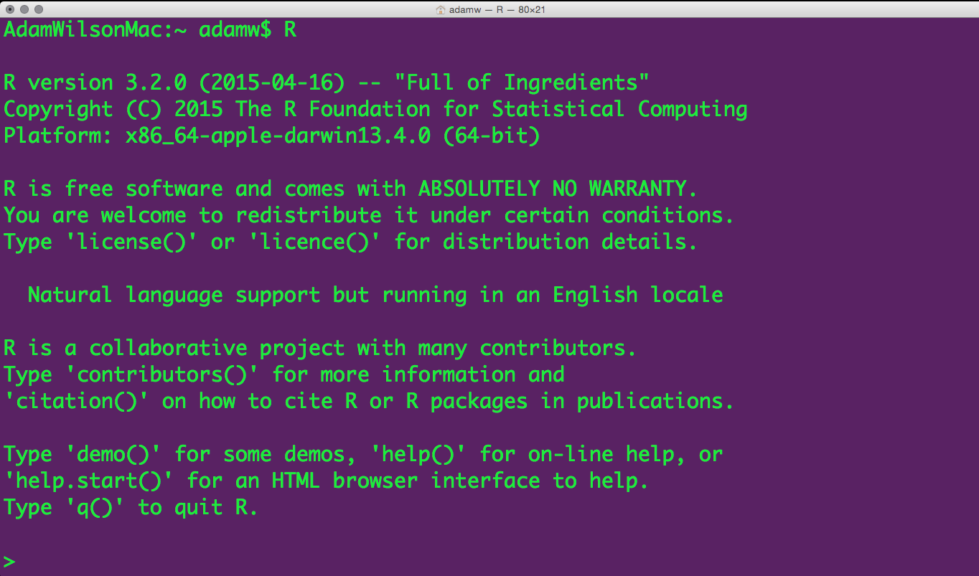
A few logistics…

Slide 2
Course Logistics
Course Participation 10%
Package Presentation 10%
Homeworks 30%
Final Project 50%
On the screen

Slide 3
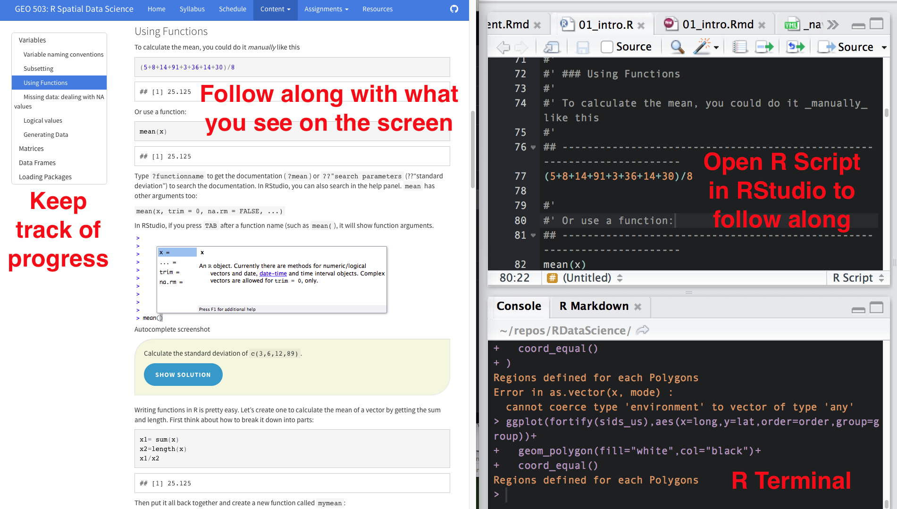
Course Participation (10%)
On the screen

Slide 4
Package Introduction (10%)
Introduce R package relevant to your research interests during a class session.
Objectives:
  Learn how to find/download/install a new package and learn how to use it
  Teach your peers about useful R packages
5 minute presentation :
  What does the package do? (1-2 slides, 1 minute)
  Author introduction (1 slide, 1 minute)
  Simple demonstration (2-3 slides, 3 minutes)

Slide 5
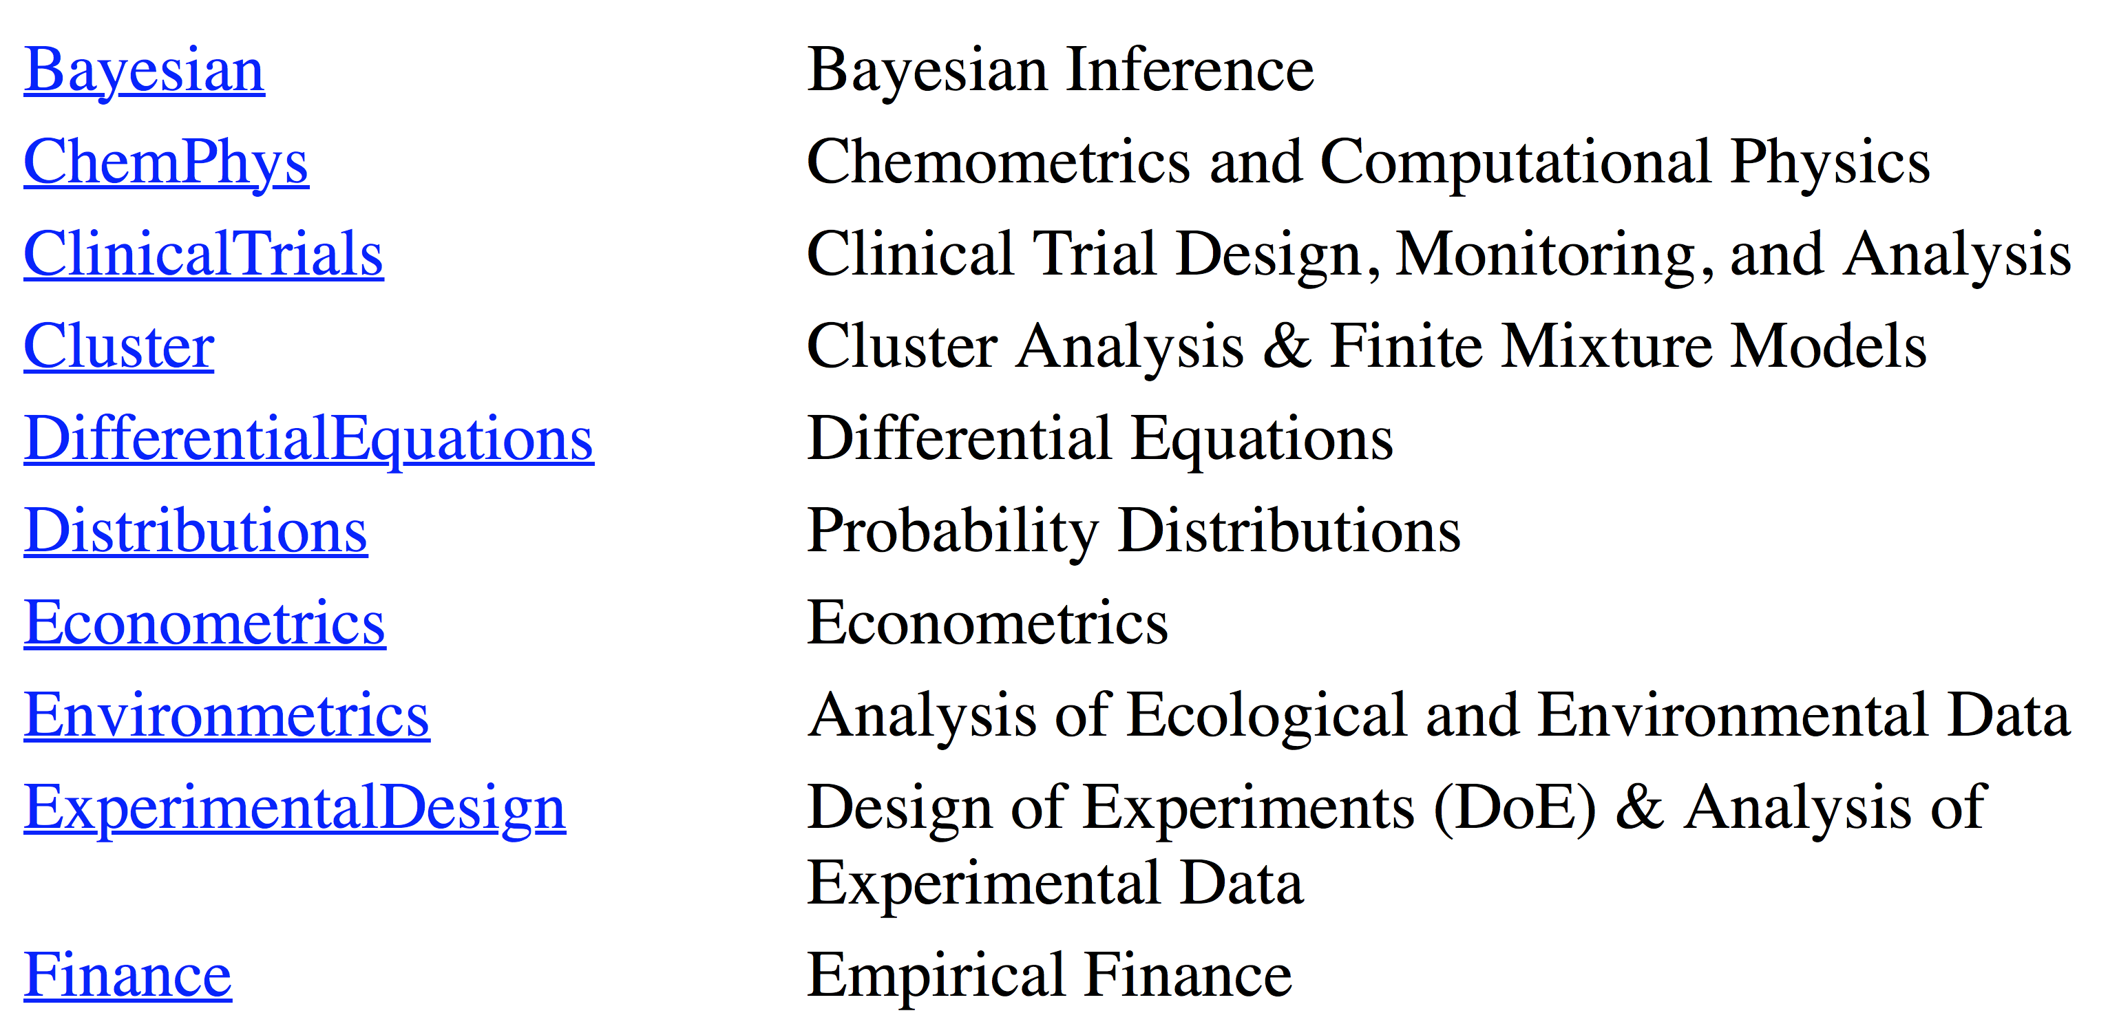
CRAN Task Views
https://cran.r-project.org/web/views/

Slide 6
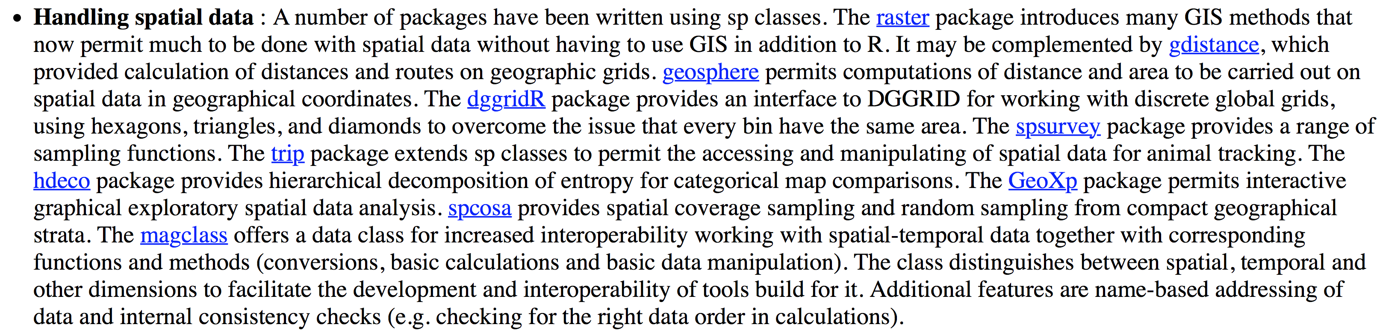
“Spatial” Task view

Slide 7
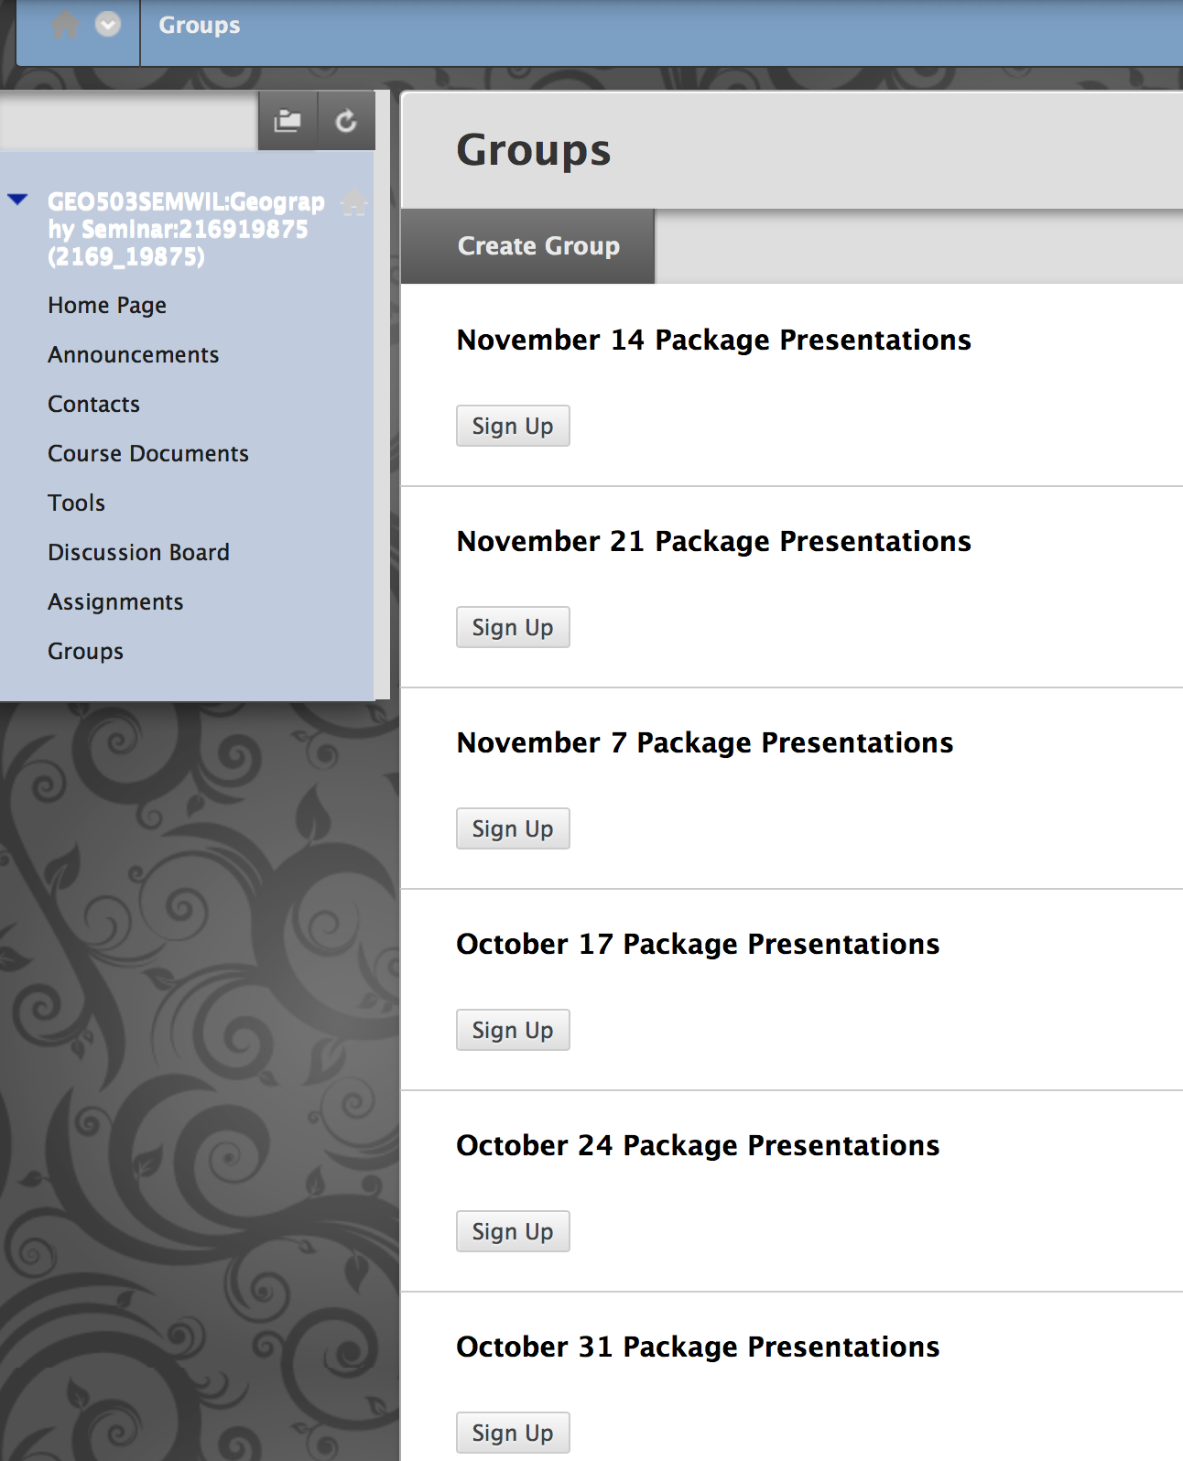
Sign up on UBLearns

Slide 8
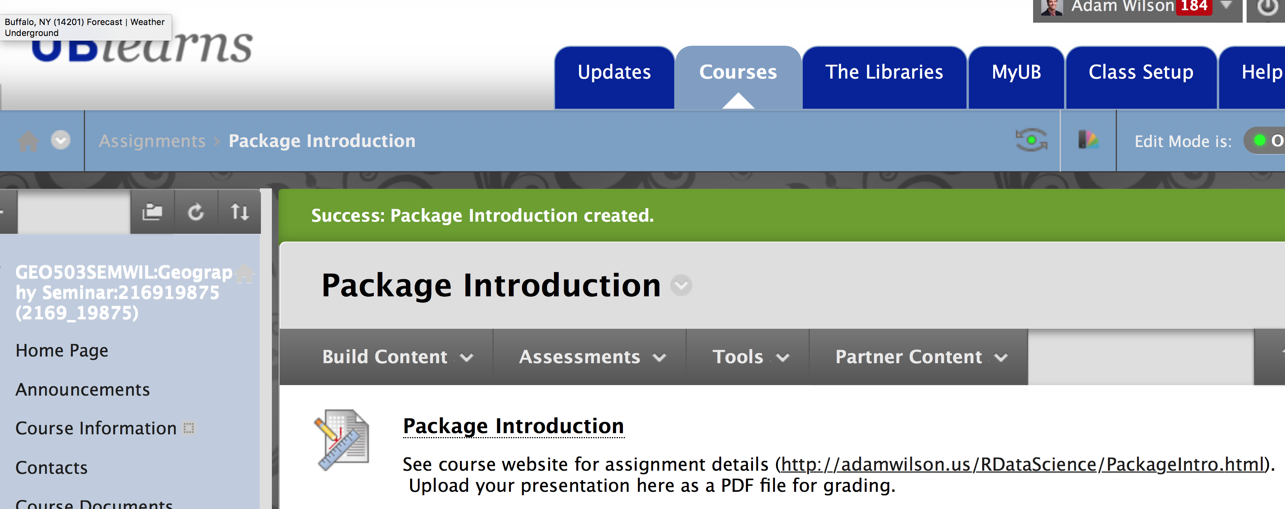
Upload PDF of presentation to UBLearns before you present!

Slide 9
Animation
Adam M. Wilson

Slide 10
Lead Author: Yihui Xie
Software engineer at Rstudio
PhD Department of Statistics, Iowa State University
Founded Chinese website Capital of Statistics & initiated 1st Chinese R conference
R packages: animation, formatR, and knitr
“I know I cannot eat code, so I cook almost every day to stay away from my computer for two hours.”

Slide 11
Animation package
Makes animations!
  probability theory
  mathematical statistics
  multivariate statistics
  nonparametric statistics
  sampling survey
  linear models
  time series
  computational statistics
  data mining
  machine learning
Save to Flash, GIF, HTML pages, PDF and videos

Slide 12
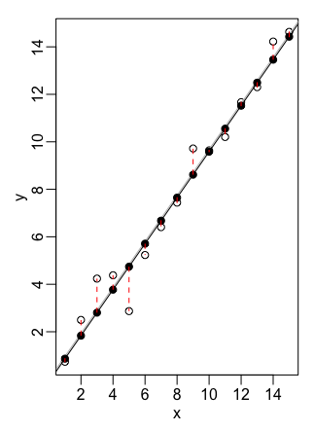
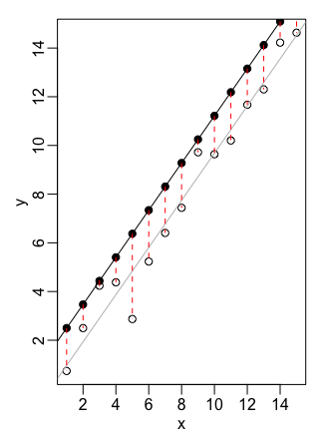
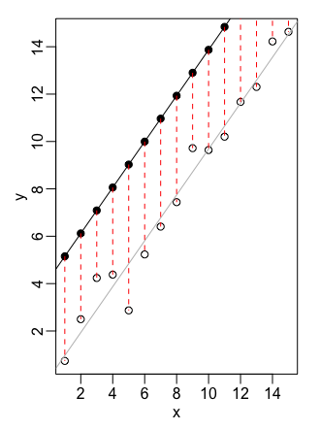
Basic steps…
Uses a ’loop’ to make a series of plots
1
2
3
Package ‘combines’ them into an animation

Slide 13
Example Code: Linear Regression
saveGIF({
  ani.options(interval = 0.3, nmax = 50)
  par(
  mar = c(4, 4, 0.5, 0.1),
  mgp = c(2, 0.5, 0),
  tcl = -0.3)
  least.squares()
  },
  img.name = "least.squares",
  htmlfile = "least.squares.gif",
  ani.height = 600, ani.width = 1000,
  title = "Demonstration of Least Squares")
Set visual parameters plot
Run the visualization
Set the output parameters

Slide 14
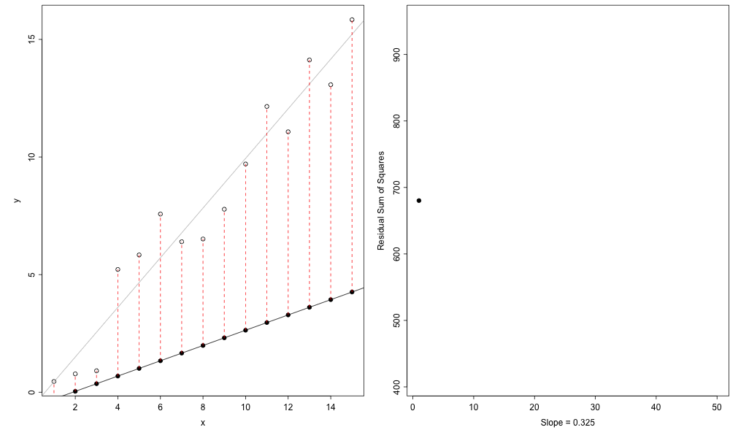
Example Output

Slide 15
Final Project & Presentation
Infographic/Poster
  10/10 Project proposal due (<1 page, 5 points)
  10/31-11/7 First draft: Peer review (5 points)
  11/14: Second draft of final project (5 points)
  12/14: Final project presentations (35 points)
Requirements
  The project must include data from at least two sources that were integrated/merged using R.
  The underlying data must be publically accessible via the web and downloaded within the R/Rmd script. If you want to use your own data, you must make it available on a website (e.g. Figshare) so that others are able to re-run your code.
  The graphic should convey at least three (and preferably four) dimensions of information (e.g. latitude, longitude, time, and one more)
50% of final grade

Slide 16
Final Project – Poster / Infographic (50%)
Title [<25 words]
Introduction [~ 150 words]
Materials and methods [~ 150 words]
Results [~200 words]
Conclusions [~200 words]
References
And all code to reproduce the analysis!!

Slide 17
Notes:
Code: Download relevant data, Clean, integrate, and summarize, Make figures (final layout in Rmarkdown or another program)

Slide 19
Project Proposal
The project proposal will be 1 page or less and outline the following:
Introduction to problem/question
Links to inspiring examples: Include links to a few (~3-5) example graphics that are similar to what you want to do.
Proposed data sources
Proposed methods
Expected results
Upload to UBLearns by midnight next Monday (10/10)

